Slide 1
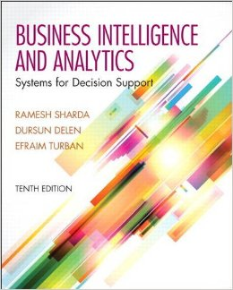
Business Intelligence and Analytics: Systems for Decision Support
(10th Edition)
Chapter 3:
Data Warehousing

Slide 2
Learning Objectives
Understand the basic definitions and concepts of data warehouses
Learn different types of data warehousing architectures; their comparative advantages and disadvantages
Describe the processes used in developing and managing data warehouses
Explain data warehousing operations
…
(Continued…)

Slide 3
Learning Objectives
Explain the role of data warehouses in decision support
Explain data integration and the extraction, transformation, and load (ETL) processes
Describe real-time (a.k.a. right-time and/or active) data warehousing
Understand data warehouse administration and security issues

Slide 4
Main Data Warehousing Topics
DW definition
Characteristics of DW
Data Marts
ODS, EDW, Metadata
DW Framework
DW Architecture & ETL Process
DW Development
DW Issues

Slide 5
What is a Data Warehouse?
A physical repository where relational data are specially organized to provide enterprise-wide, cleansed data in a standardized format
“The data warehouse is a collection of integrated, subject-oriented databases designed to support DSS functions, where each unit of data is non-volatile and relevant to some moment in time”

Slide 6
A Historical Perspective to Data Warehousing

Slide 7
Characteristics of DWs
Subject oriented
Integrated
Time-variant (time series)
Nonvolatile
Summarized
Not normalized
Metadata
Web based, relational/multi-dimensional
Client/server, real-time/right-time/active...

Slide 8
Data Mart
A departmental small-scale “DW” that stores only limited/relevant data
Dependent data mart
A subset that is created directly from a data warehouse
Independent data mart
A small data warehouse designed for a strategic business unit or a department

Slide 9
Other DW Components
Operational data stores (ODS)
A type of database often used as an interim area for a data warehouse
Oper marts - an operational data mart.
Enterprise data warehouse (EDW)
A data warehouse for the enterprise.
Metadata: Data about data.
In a data warehouse, metadata describe the contents of a data warehouse and the manner of its acquisition and use

Slide 10
A Generic DW Framework

Slide 11
DW Architecture
Three-tier architecture
Data acquisition software (back-end)
The data warehouse that contains the data & software
Client (front-end) software that allows users to access and analyze data from the warehouse
Two-tier architecture
First two tiers in three-tier architecture is combined into one
… sometimes there is only one tier?

Slide 12
DW Architectures
3-tier
architecture
2-tier
architecture
1-tier
Architecture
?

Slide 13
Data Warehousing Architectures
Issues to consider when deciding which architecture to use:
Which database management system (DBMS) should be used?
Will parallel processing and/or partitioning be used?
Will data migration tools be used to load the data warehouse?
What tools will be used to support data retrieval and analysis?

Slide 14
A Web-Based DW Architecture

Slide 15
Alternative DW Architectures

Slide 16
Alternative DW Architectures
Each architecture has advantages and disadvantages!
Which architecture is the best?

Slide 17
Ten factors that potentially affect the architecture selection decision
Information interdependence between organizational units
Upper management’s information needs
Urgency of need for a data warehouse
Nature of end-user tasks
Constraints on resources
Strategic view of the data warehouse prior to implementation
Compatibility with existing systems
Perceived ability of the in-house IT staff
Technical issues
Social/political factors

Slide 18
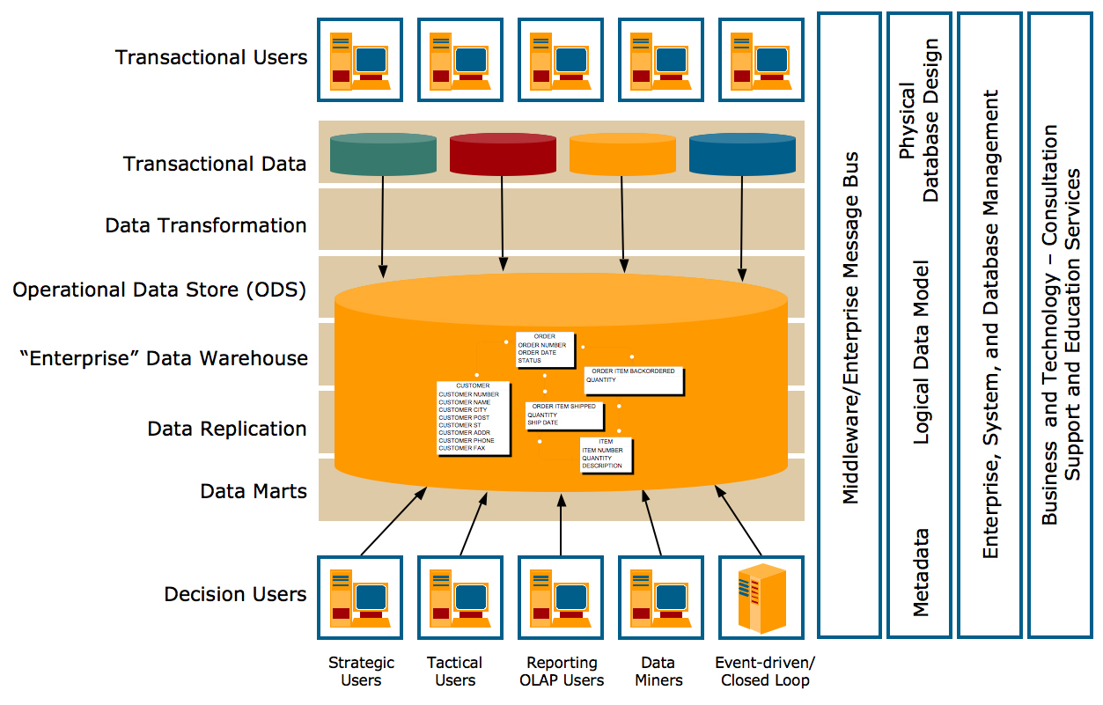
Teradata Corp. DW Architecture

Slide 19
Data Integration and the Extraction, Transformation, and Load Process
ETL = Extract Transform Load
Data integration
Integration that comprises three major processes: data access, data federation, and change capture.
- Data access: the ability to access and extract data from any data sources.
- Data federation: the integration of business views across multiple data stores.
- Change capture: based on the identification, capture, and delivery of the changes made to enterprise data sources.

Slide 20
Data Integration and the Extraction, Transformation, and Load Process
Various integration technologies enable data and metadata integration:
Enterprise application integration (EAI)
A technology that provides a vehicle for pushing data from source systems into a data warehouse. It involves integrating application functionality and is focused on sharing functionality across systems such as CRM, ERP, and SCM. It enables a communication path for applications to share information.

Slide 21
Data Integration and the Extraction, Transformation, and Load Process
Various integration technologies enable data and metadata integration (Cont.):
Enterprise information integration (EII)
An evolving tool space that promises real-time data integration from a variety of sources, such as relational or multidimensional databases, Web services, etc.
It focuses on providing a unified view of data from multiple sources, without necessarily integrating the applications themselves, making data integrated from multiple sources accessible through a single interface.

Slide 22
Data Integration and the Extraction, Transformation, and Load Process
The ETL process: 70% of the time for a data-centric project

Slide 23
ETL (Extract, Transform, Load)
Issues affecting the purchase of an ETL tool
Data transformation tools are expensive
Data transformation tools may have a long learning curve
Important criteria in selecting an ETL tool
Ability to read from and write to an unlimited number of data sources/architectures
Automatic capturing and delivery of metadata
A history of conforming to open standards
An easy-to-use interface for the developer and the functional user

Slide 24
Data Warehouse Development
Data warehouse development approaches
Inmon Model: EDW approach (top-down), adapts traditional relational database tools.
Kimball Model: Data mart approach (bottom-up), employs dimensional modeling.
Which model is best?
Table 3.3 provides a comparative analysis between EDW and Data Mart approach, and Table 3.4 provides the essential differences between the two approaches.
One alternative is the hosted warehouse

Slide 25
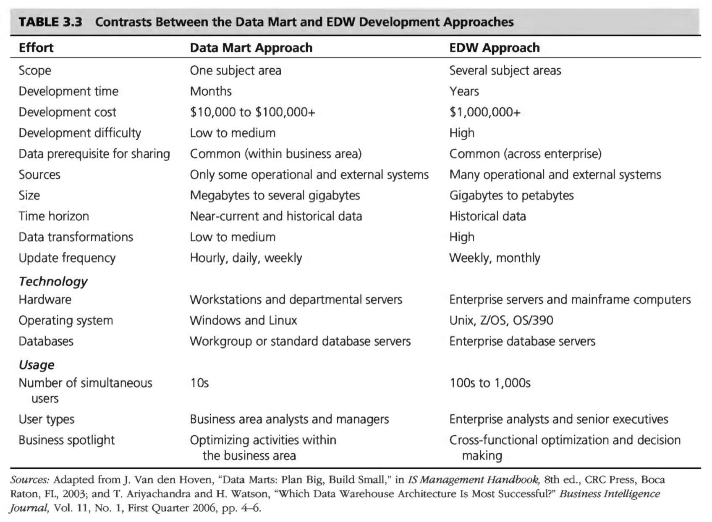
Data Warehouse Development

Slide 26
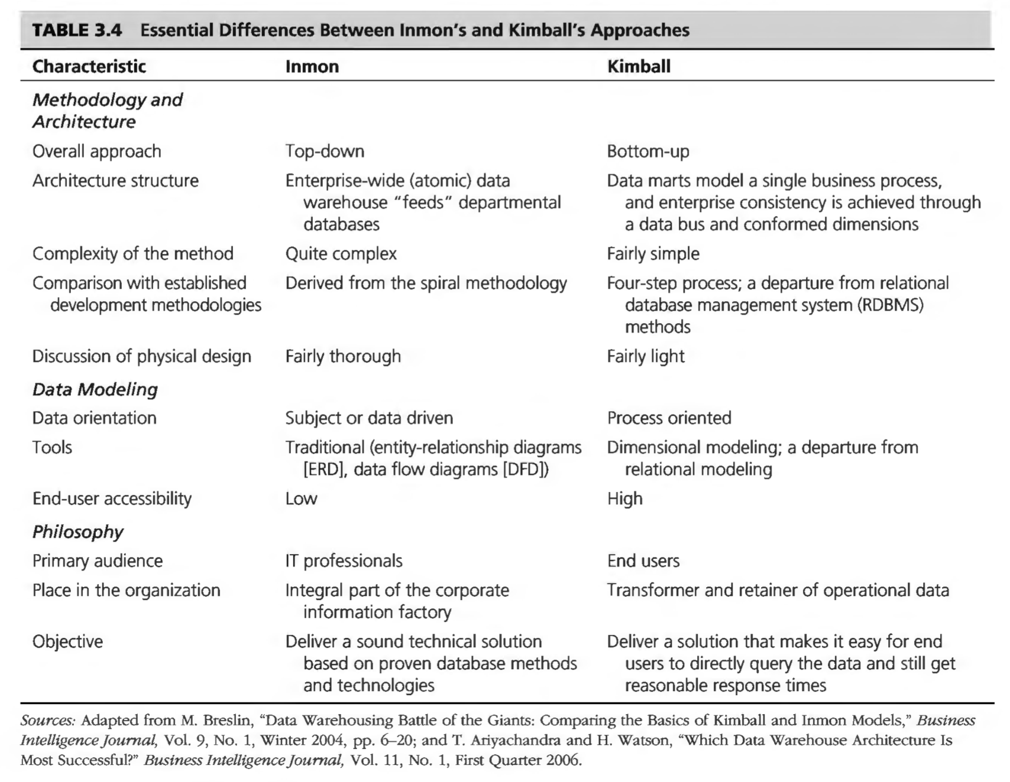
Data Warehouse Development

Slide 27
Additional DW Considerations Hosted Data Warehouses
Benefits:
Requires minimal investment in infrastructure
Frees up capacity on in-house systems
Frees up cash flow
Makes powerful solutions affordable
Enables solutions that provide for growth
Offers better quality equipment and software
Provides faster connections

Slide 28
Representation of Data in DW
Dimensional Modeling
A retrieval-based system that supports high-volume query access
Star schema
The most commonly used and the simplest style of dimensional modeling
Contain a fact table surrounded by and connected to several dimension tables
Snowflakes schema
An extension of star schema where the diagram resembles a snowflake in shape

Slide 29
Multidimensionality
The ability to organize, present, and analyze data by several dimensions, such as sales by region, by product, by salesperson, and by time (four dimensions)
Multidimensional presentation
Dimensions: products, salespeople, market segments, business units, geographical locations, distribution channels, country, or industry
Measures: money, sales volume, head count, inventory profit, actual versus forecast
Time: daily, weekly, monthly, quarterly, or yearly

Slide 30
Star versus Snowflake Schema

Slide 31
Analysis of Data in DW
OLTP vs. OLAP…
OLTP (online transaction processing)
Capturing and storing data from ERP, CRM, POS, …
The main focus is on efficiency of routine tasks
OLAP (Online analytical processing)
Converting data into information for decision support
Data cubes, drill-down / rollup, slice & dice, …
Requesting ad hoc reports
Conducting statistical and other analyses
Developing multimedia-based applications

Slide 32
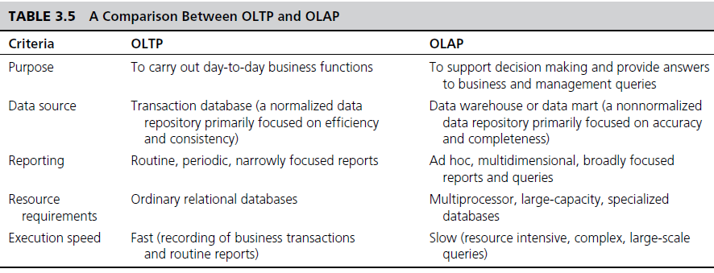
OLAP vs. OLTP

Slide 33
OLAP Operations
Slice - a subset of a multidimensional array. A slice operation involves selecting a subset of the data cube by fixing the value of one dimension while allowing the other dimensions to vary.
Dice - a slice on more than two dimensions. A dice operation involves selecting a sub-cube of the data cube by specifying specific ranges or values for multiple dimensions.
Drill Down/Up - navigating among levels of data ranging from the most summarized (up) to the most detailed (down)

Slide 34
OLAP Operations
Roll Up - computing all of the data relationships for one or more dimensions (i.e. rather than drilling-up on a single dimension, it involves aggregating data across one or more dimensions, it is focused on summarizing data to provide broader insights)
Pivot - used to change the dimensional orientation of a report or an ad hoc query-page display

Slide 35
OLAP
Slicing Operations on a Simple Three-Dimensional
Data Cube

Slide 36
Variations of OLAP
Relational OLAP (ROLAP)
The implementation of an OLAP database on top of an existing relational database.
Multidimensional OLAP (MOLAP)
OLAP implemented via a specialized multidimensional database (or data store) that summarizes transactions into multidimensional views ahead of time.
See next slide for a comparison between the two approaches
Hybrid OLAP (HOLAP)
Attempts to combine the best features of ROLAP and MOLAP. It stores part of the data in a multidimensional format (MOLAP store) and another part in a relational format (ROLAP store). HOLAP can offer a balance between the flexibility/scalability of ROLAP and the performance of MOLAP.

Slide 37
Variations of OLAP (Cont.)
ROLAP | MOLAP
Stores data in a relational database. It uses the standard tables of a relational database to store data and perform complex queries. Can be slower than MOLAP for complex calculations and large data sets because it requires on-demand calculation at query time. ROLAP is highly flexible in terms of data model adaptability. It is easy to make changes in business logic or to add new dimensions and measures. ROLAP systems can scale to handle large volumes of data, as they leverage the scalability features of the underlying relational database management systems (RDBMS). | Stores data in a multidimensional cube, allowing for pre-computation and storage of information. Offers fast query performance, especially for slice-and-dice operations, due to the pre-aggregation of data. MOLAP is less flexible in terms of data model changes. Since data is stored in a predefined multidimensional cube structure, making changes to the data model (like adding new dimensions or altering hierarchies) can require significant restructuring of the cubes, which is more complex and time-consuming than in ROLAP. Its scalability in terms of data volume is generally constrained by the cube's size and the complexity of maintaining large cubes.

Slide 38
Technology Insights 3.2 Hands-On DW with MicroStrategy
A wealth of teaching and learning resources can be found at TUN portal
www.teradatauniversitynetwork.com
The available resource includes scripted demonstrations, assignments, white papers, etc…

Slide 39
DW Implementation Issues
Implementing a data warehouse is generally a massive effort that must be planned and executed according to established methods.
However, the project life cycle has many facets, and no single person can be an expert in each area. Here we discuss specific ideas and issues as they relate to data warehousing:
Ariyachandra and Watson (2006a) proposed some benchmarks for BI and data warehousing success.
The Data Warehousing Institute (tdwi.org) has developed a data warehousing maturity model that an enterprise can apply in order to benchmark its evolution.
Data warehouse projects have many risks. Most of them are also found in other IT projects, but data warehousing risks are more serious because data warehouses are expensive, time-and-resource demanding, large-scale projects.

Slide 40
Successful DW Implementation Things to Avoid
Starting with the wrong sponsorship chain
Setting expectations that you cannot meet
Engaging in politically naive behavior
Loading the data warehouse with information just because it is available
Believing that data warehousing database design is the same as transactional database design
Choosing a data warehouse manager who is technology oriented rather than user oriented

Slide 41
Successful DW Implementation Things to Avoid (Cont.)
Focusing on traditional internal record-oriented data and ignoring the value of external data and of text, images, and, perhaps, sound and video.
Delivering data with overlapping and confusing definitions.
Believing promises of performance, capacity, and scalability.
Believing that your problems are over when the data warehouse is up and running.
Focusing on ad hoc data mining and periodic reporting instead of alerts.

Slide 42
Successful DW Implementation Success Factors
In many organizations, a data warehouse will be successful only if:
There is strong senior management support for its development.
There is a project champion who is high up in the organizational chart.
User participation in the development of data and access modeling is a critical success factor in data warehouse development.
Access modeling is needed to determine how data are to be retrieved from a data warehouse, and it assists in the physical definition of the warehouse.
The team skills needed to develop and implement a data warehouse include in-depth knowledge of the database technology and development tools used.

Slide 43
Massive DW and Scalability
Given that the size of data warehouses is expanding at an exponential rate, scalability is an important issue.
The main issues pertaining to scalability:
The amount of data in the warehouse
How quickly the warehouse is expected to grow
The number of concurrent users
The complexity of user queries
Good scalability means that queries and other data-access functions will grow (ideally) linearly with the size of the warehouse

Slide 44
Real-Time/Active DW/BI
The process of loading and providing data via a data warehouse as they become available.
Levels of data warehouses (next slide):
Reports what happened
Some analysis occurs
Provides prediction capabilities,
Operationalization
Becomes capable of making events happen.

Slide 45
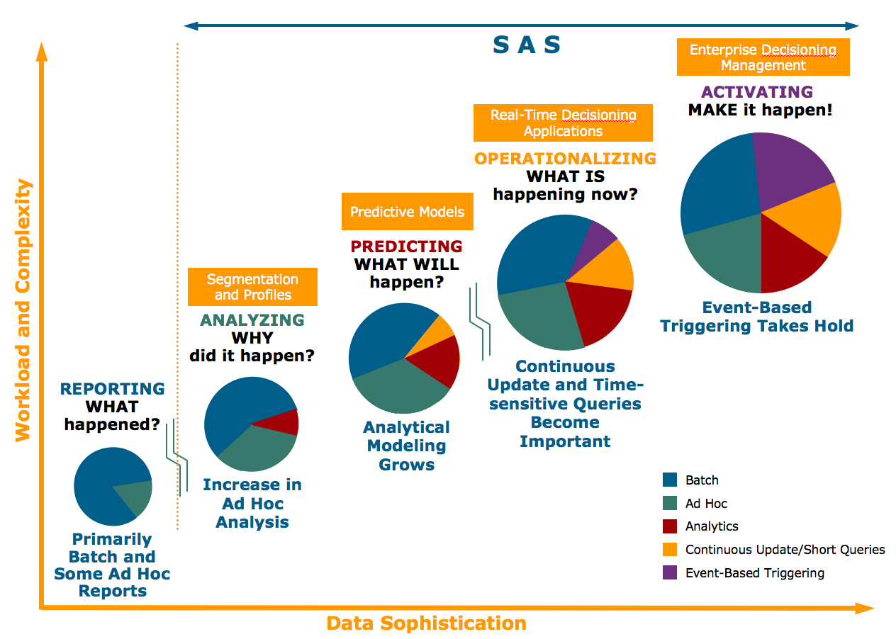
Enterprise Decision Evolution and Data Warehousing

Slide 46
Real-Time/Active DW/BI (Cont.)
Teradata Corporation provides the baseline requirements to support an EDW. It also provides the new traits of active data warehousing required to deliver data freshness, performance, and availability and to enable enterprise decision management (see next slide for an example).
An ADW offers an integrated information repository to drive strategic and tactical decision support within an organization.
With real-time data warehousing, instead of extracting operational data from an OLTP system in nightly batches into an ODS (operational data store, a type of database that is often used as an interim staging area for a data warehouse), data are assembled from OLTP systems as and when events happen and are moved at once into the data warehouse.
This permits the instant updating of the data warehouse and the elimination of an ODS. At this point, tactical and strategic queries can be made against the RDW to use immediate as well as historical data.

Slide 47
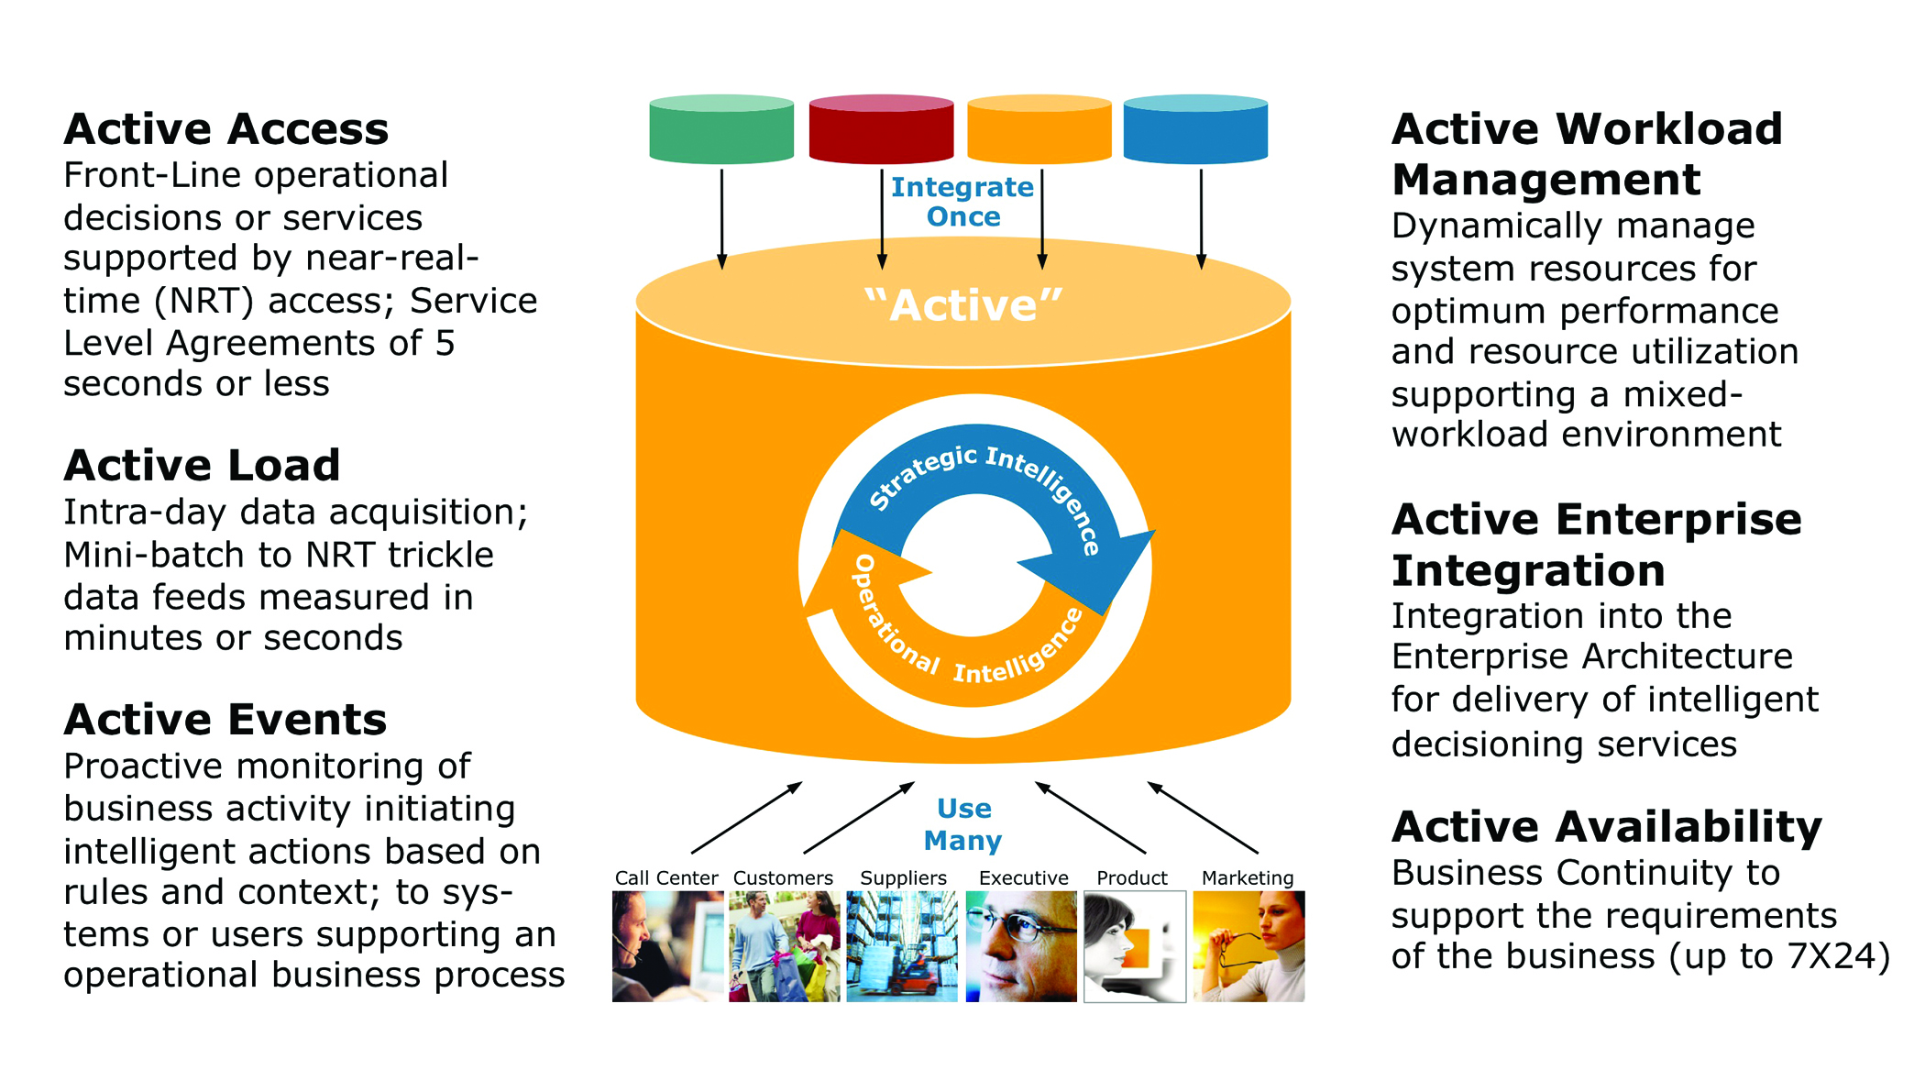
Real-Time/Active DW at Teradata

Slide 48
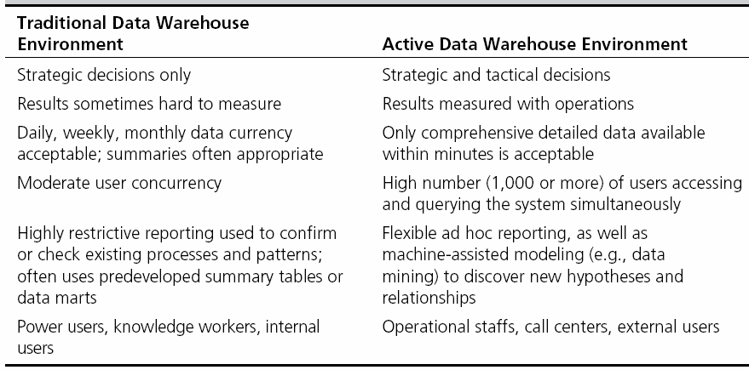
Traditional versus Active DW

Slide 49
Real-Time/Active DW/BI
Concerns about real-time BI
Not all data should be updated continuously
Mismatch of reports generated minutes apart
May be cost prohibitive
May also be infeasible

Slide 50
DW Administration and Security
Data warehouse administrator (DWA)
DWA should…
have the knowledge of high-performance software, hardware and networking technologies
possess solid business knowledge and insight
be familiar with the decision-making processes so as to suitably design/maintain the data warehouse structure
possess excellent communications skills.
Security and privacy is a pressing issue in DW.
Companies must create security procedures that are effective yet flexible to conform to numerous privacy regulations, governmental regulations (such as HIPAA, etc)

Slide 51
DW Administration and Security
According to Elson and Leclerc (2005), effective security in a data warehouse should focus on four main areas:
Establishing effective corporate and security policies and procedures. An effective security policy should start at the top, with executive management, and should be communicated to all individuals within the organization.
Implementing logical security procedures and techniques to restrict access. This includes user authentication, access controls, and encryption technology.
Limiting physical access to the data center environment.
Establishing an effective internal control review process with an emphasis on security and privacy.

Slide 52
The Future of DW
Sourcing…
Web, social media, and Big Data
Open source software
SaaS (software as a service)
Cloud computing
Infrastructure…
Columnar
Real-time DW
Data warehouse appliances
Data management practices/technologies
In-database processing technologies, In-memory storage technologies, New DBMS.
Advanced analytics

Slide 53
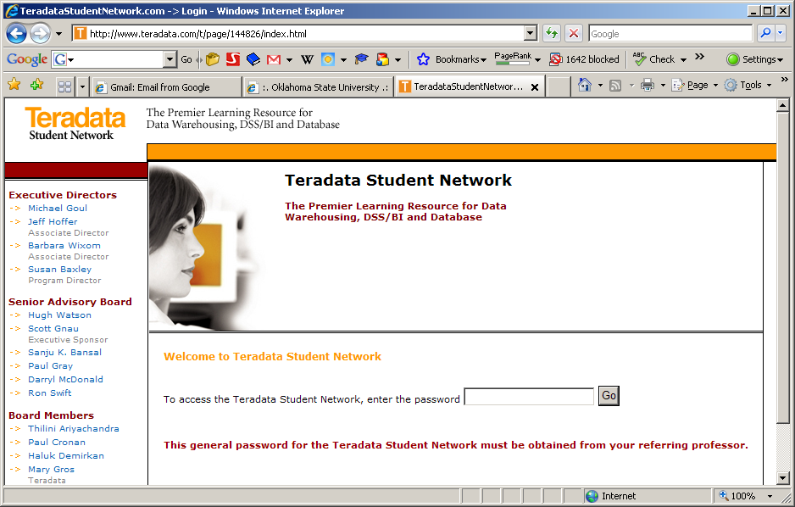
Free of Charge DW Portal for Teaching & Learning
www.TeradataStudentNetwork.com

